Slide 1
INDIAN PREMIER LEAGUE
PRESENTED BY DEEPIKA PAL
1

Slide 2
INTRODUCTION
The Indian Premier League (IPL) is a professional Twenty20 cricket league in India, widely regarded as one of the most popular and lucrative T20 leagues globally. Launched in 2008 by the Board of Control for Cricket in India (BCCI), the IPL features franchise teams representing different cities. Known for its high-octane cricket, star-studded line-ups, and innovative formats, the IPL has become a cricketing extravaganza, attracting top international players.
With its blend of entertainment and competitive cricket, the IPL has not only revolutionized the sport but has also gained a massive fan base, making it a premier event in the cricketing calendar.
2

Slide 3
FIRST EDITION
IPL OVERVIEW
2008
FORMAT
The Indian Premier League (IPL) premier Twenty20 cricket league in India. Renowned for its high-energy matches and star-studded teams representing cities, the IPL has become a global cricketing phenomenon. With innovative formats and top international players, it blends entertainment and competition, captivating a massive fan base. The IPL has redefined modern cricket, elevating it beyond a sport to a cultural spectacle.
Twenty20
NUMBER OF TEAMS
TEN ( 10 )
ADMINISTRATOR
BCCI
( Board of Control for Cricket in India )
HEADQUARTERS
Cricket Centre, Churchgate,
Mumbai, Maharashtra
3

Slide 4

TEAM PLAYING
CHENNAI SUPER KINGS
MUMBAI INDIANS
DELHI CAPITALS
PUNJAB KINGS
GUJRAT TITANS
RAJASTHAN ROYALS
ROYAL CHALLENGERS BANGALORE
KOLKATA KNIGHT RIDERS
LUCKNOW SUPER GIANTS
SUNRISERS HYDERABAD
4

Slide 5
IPL 2024 VENUE
Arun Jaitley Stadium
(Delhi)
Capacity: 35,200
Edan Gardens
(Kolkata)
Capacity: 68,000
Narendra Modi Stadium
(Ahmedabad)
Capacity: 132,000
M A Chidambaram Stadium
Wankhede Stadium
(Chennai)
(Mumbai)
Capacity: 38,200
Capacity: 33,108
Dy Patil Stadium
(Navi Mumbai)
M Chinnaswamy Stadium
Capacity: 55,000
(Bengaluru)
Capacity: 33,800
5

Slide 6
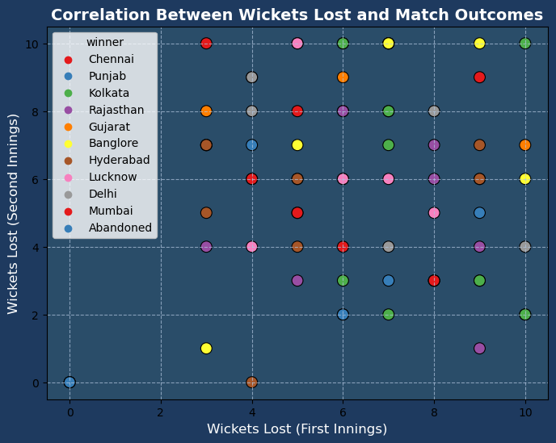
Correlation Between Wickets Lost and Match Outcomes in IPL 2024
The scatter plot visualizes the relationship between the number of wickets lost in both innings and the match outcomes. There appears to be a strong correlation between fewer wickets lost in the second innings and winning outcomes. Teams that lose fewer wickets in the second innings tend to secure victories more often, suggesting that successful chases are closely tied to preserving wickets during the chase.
6

Slide 7
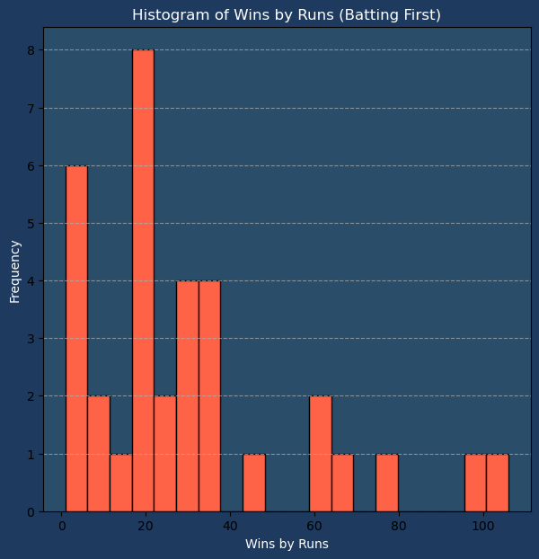
Distribution of Wins by Runs for Teams Batting First in IPL 2024
The histogram shows the distribution of wins by runs for teams that batted first in IPL 2024. The majority of wins occur within a margin of 20-50 runs, indicating that teams often manage to set defendable scores without overwhelming their opponents. However, there are some instances where teams won by a larger margin, demonstrating dominance in both batting and bowling performances.
7

Slide 8
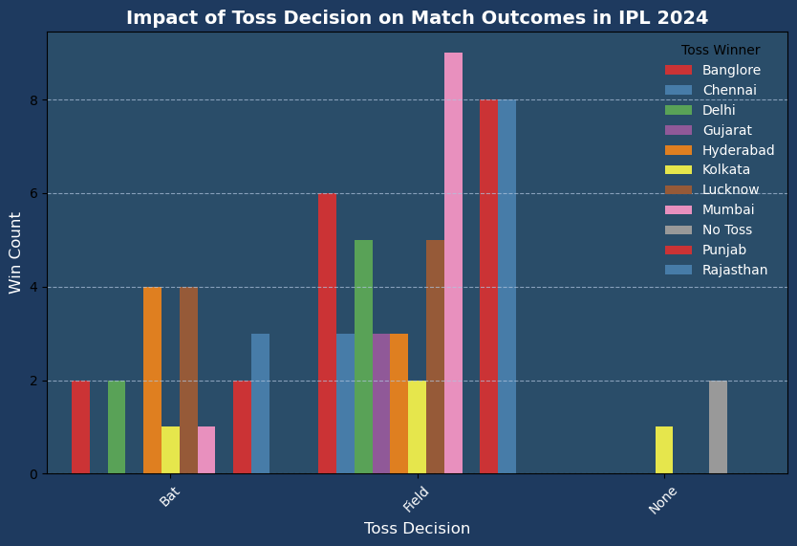
Impact of Toss Decision on Match Outcomes in IPL 2024
This bar chart compares the outcomes of teams that chose to bat or field after winning the toss in IPL 2024. Teams opting to field after winning the toss tend to have a higher win count, suggesting that chasing was often a favorable strategy. However, teams that chose to bat also saw significant success in certain conditions.
8

Slide 9
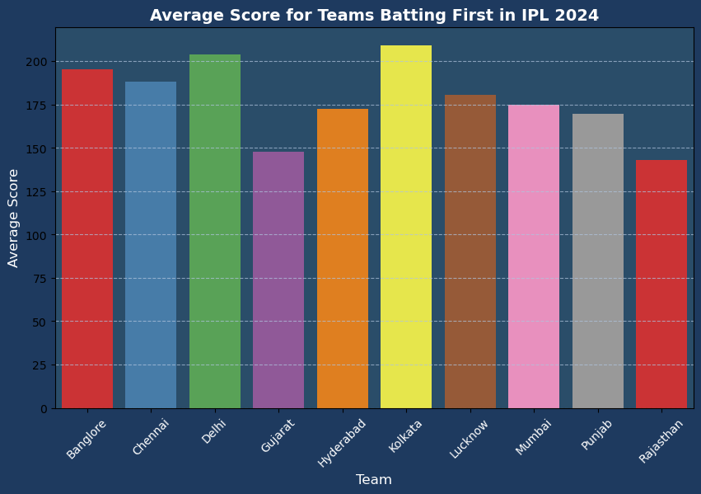
Average Score for Teams Batting First in IPL 2024
This bar chart displays the average scores for each team when batting first in IPL 2024. Teams like Chennai Super Kings and Mumbai Indians consistently set higher targets, reflecting their strong top-order performance. Other teams show more variation, with some struggling to set competitive totals when batting first.
9

Slide 10
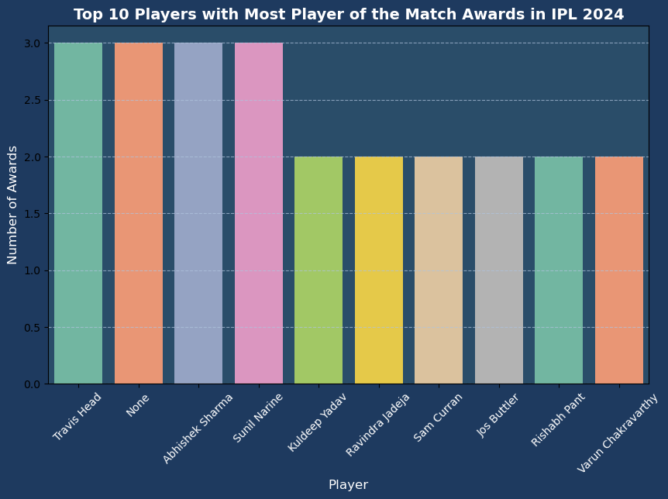
Top 10 Players with Most Player of the Match Awards in IPL 2024
This bar chart shows the top 10 players with the most 'Player of the Match' awards during the IPL 2024 season. The leading players, consistently delivering match-winning performances, have significantly contributed to their team's success. The top player stands out with a clear lead in awards, reflecting their exceptional individual performance throughout the tournament.
10

Slide 11
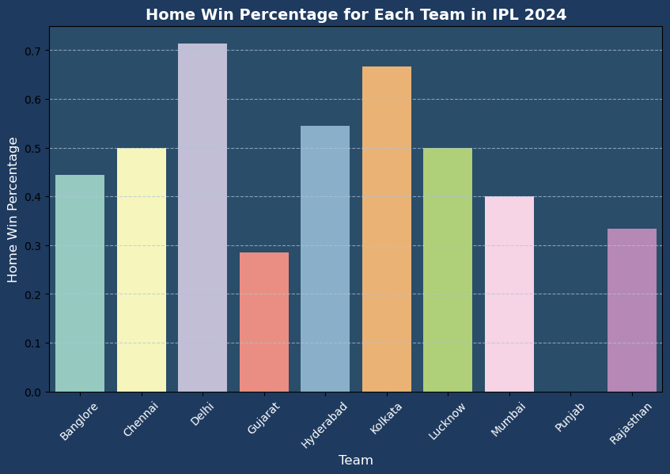
Home Win Percentage for Each Team in IPL 2024
This bar chart shows the home win percentages for each team in IPL 2024. Teams like Chennai Super Kings and Mumbai Indians demonstrate strong home-ground performances, winning a higher percentage of their matches at home. Other teams show more variation in their success rates when playing on home turf, suggesting that home-ground advantage may not be as significant for every team
11

Slide 12
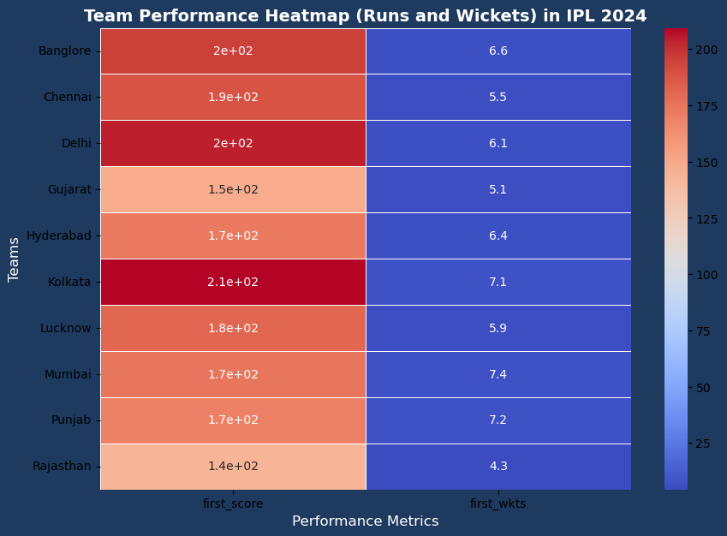
Team Performance Heatmap (Runs and Wickets) in IPL 2024
This heatmap shows the average performance of each team in IPL 2024 based on two key metrics: total runs scored and wickets taken. Teams with higher average scores and lower wickets lost, such as Chennai Super Kings and Mumbai Indians, indicate stronger overall performance. The variation in scores and wickets highlights differences in team strategies and execution throughout the season
12

Slide 13
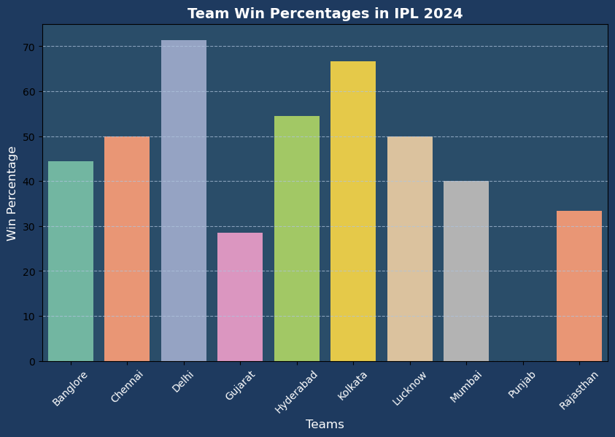
Team Win Percentages in IPL 2024
This bar chart displays the win percentages for each team in IPL 2024. Teams like Chennai Super Kings and Mumbai Indians maintain higher win rates, reflecting their consistent performance throughout the season. Other teams, such as Rajasthan Royals and Delhi Capitals, show more varied success, indicating fluctuating form during the tournament
13

Slide 14
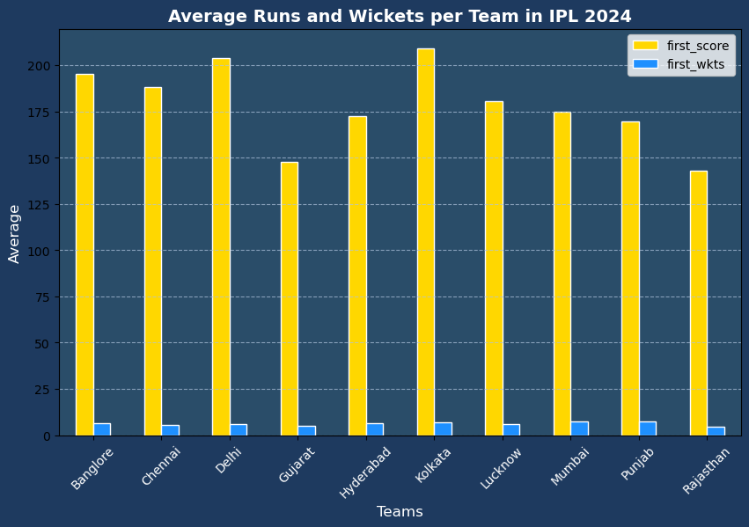
Average Runs and Wickets per Team in IPL 2024
This bar chart illustrates the average runs scored and wickets taken by each team in IPL 2024. Teams like Chennai Super Kings and Mumbai Indians consistently scored higher runs while losing fewer wickets, reflecting strong performances both in batting and bowling. Other teams show a wider range of performance, with some excelling in batting but struggling to take wickets
14

Slide 15
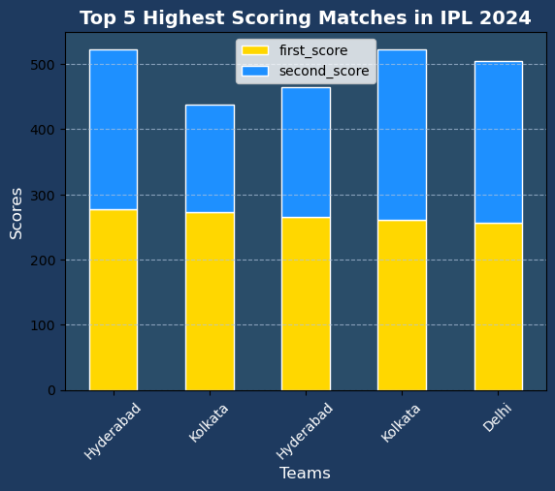
Top 5 Highest Scoring Matches in IPL 2024
This bar chart shows the top 5 highest-scoring matches in IPL 2024, where both teams managed to post high scores. The stacked bars represent the first and second innings scores. Teams that scored heavily in the first innings often saw strong competition in the second innings, with some matches coming close to high-scoring chases
15

Slide 16
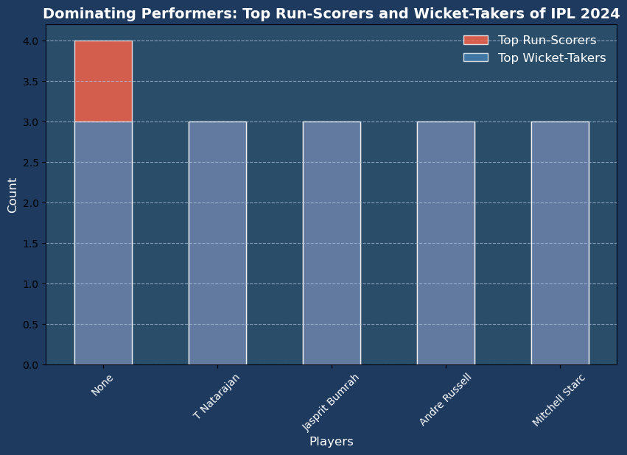
Dominating performers: Top Run-Scorers and Wickets-Takers in IPL 2024
This bar chart showcases the top performers of IPL 2024, featuring the leading run-scorers and wicket-takers. These players have significantly impacted the outcomes of matches, with standout performances in both batting and bowling, contributing heavily to their team's success
16

Slide 17
IPL RECORDS
ALL TIME BATTING LEADERS
Orange Cap
Most Fours
Most Sixes
Highest Score
2,278
750
375
175
Runs
Fours
Sixes
Score
VIRAT KOHLI
SHIKHAR DHAWAN
CHRIS GAYLE
CHRIS GAYLE
ALL TIME BOWLING LEADERS
Purple Cap
Best Bowling Figures
Best Bowling Average
Most Dots
187
6/12
17.92
1534
Wickets
Wickets/Runs
YUZVENDRA CHAHAL
ALZARRI JOSEPH
LUNGI NGIDI
BHUVNESHWAR
17

Slide 18
IPL CHAMPIONS
18
The 2024 IPL Champions are [Kolkata Knight Riders], defeating [Sunrisers Hyderabad] in a thrilling final
Their outstanding performances throughout the season secured them the prestigious title
YEAR
WINNER
RUNNER-UP
YEAR
WINNER
RUNNER-UP
2008
Rajasthan Royals
Chennai Super Kings
2016
Sunrisers Hyderabad
RCB ( Royal Challengers Bangalore )
2009
Deccan Chargers
RCB ( Royal Challengers Bangalore )
2017
Mumbai Indians
Rising Pune Supergiant
2010
Chennai Super Kings
Mumbai Indians
2018
Chennai Super Kings
Sunrisers Hyderabad
2011
Chennai Super Kings
RCB ( Royal Challengers Bangalore )
2019
Mumbai Indians
Chennai Super Kings
2012
Kolkata Knight Riders
Chennai Super Kings
2020
Mumbai Indians
Delhi Capitals
2013
Mumbai Indians
Chennai Super Kings
2021
Kolkata Knight Riders
Chennai Super Kings
2014
Kolkata Knight Riders
Punjab Kings
2022
Gujarat Titans
Rajasthan Royals
2015
Mumbai Indians
Chennai Super Kings
2023
Chennai Super Kings
Gujarat Titans
2024
Kolkata Knight Riders
Sunrisers Hyderabad

Slide 19










LIST OF BROADCASTERS
TERRITORY
LICENSEE
Star Sports
India
Jio Cinema ( Internet )
Bangladesh
T Sports , GTV , T Sports ( App )
Australia
Foxtel, Fox Cricket, Kayo Sports, Kayo Freebies
Afghanistan
Ariana Television Network
Indonesia
Vidio ( Internet )
Ireland
Sky Sports, DAZN
United Kingdom
Sky Sports, DAZN
Middle East and North Africa
Times Internet
New Zealand
Sky Sports
South Africa
Super Sport
United States
Willow Tv
19

Slide 20
THANK YOU
deepikpal123@gmail.com
This presentation prepared by Deepika Pal,
a Data Analyst specializing in Python and visualization
20

